Slide 1


COMPARATIVE ANALYSES OF YOLO v5, v8, v11
and Localization
Team 6
Department of Computer Engineering
Ataturk University
Artificial Intelligence Systems - Resul TUGAY
30.12.2025

Slide 2
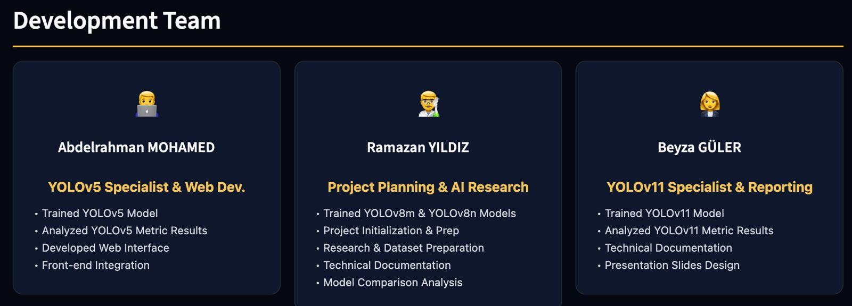
OUR TEAM

Slide 3
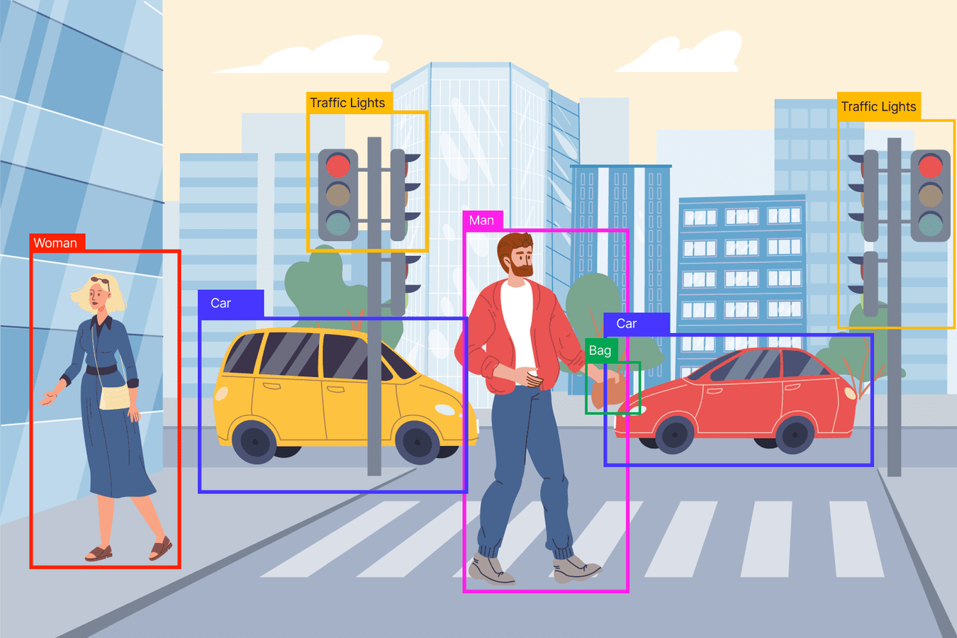
Abstract
Real-time object detection using YOLOv8
Pre-trained COCO model + custom dataset plan
Streamlit-based web deployment
Current state: Intermediate prototype

Slide 4
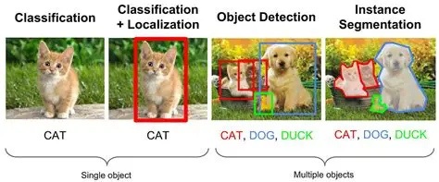
Introduction – Object Detection
What is object detection?
Difference from image classification
Real-time requirement

Slide 5
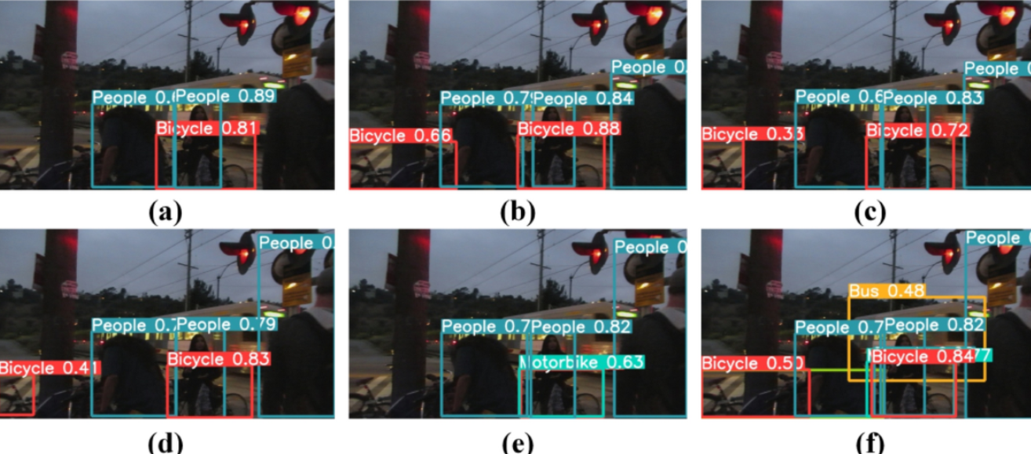
Problems
Title: Problem Definition
Real-time deployment challenges
Computational cost of high-accuracy models
Limited accessibility of web-based systems

Slide 6
Input – Output
Input:
Output:
Bounding boxes
Images
Video streams
Class labels
Webcam input
Confidence scores

Slide 7
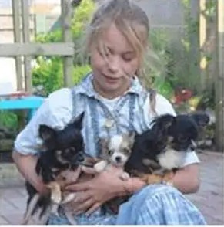
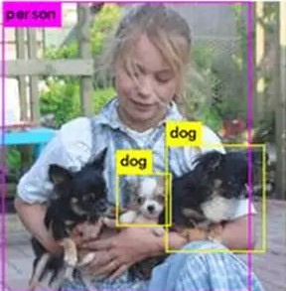
Input – Output
Input:
Output:

Slide 8
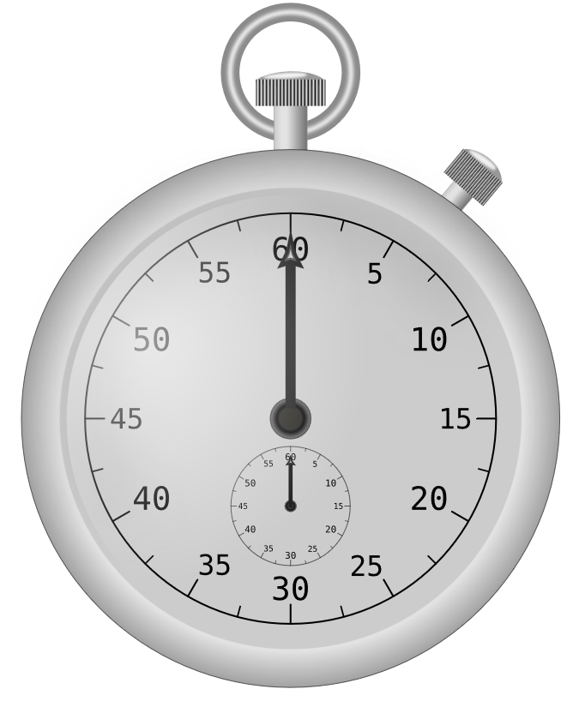

Goals
Real-time object detection
High FPS performance
Easy-to-use web interface
Scalable architecture for future extensions

Slide 9
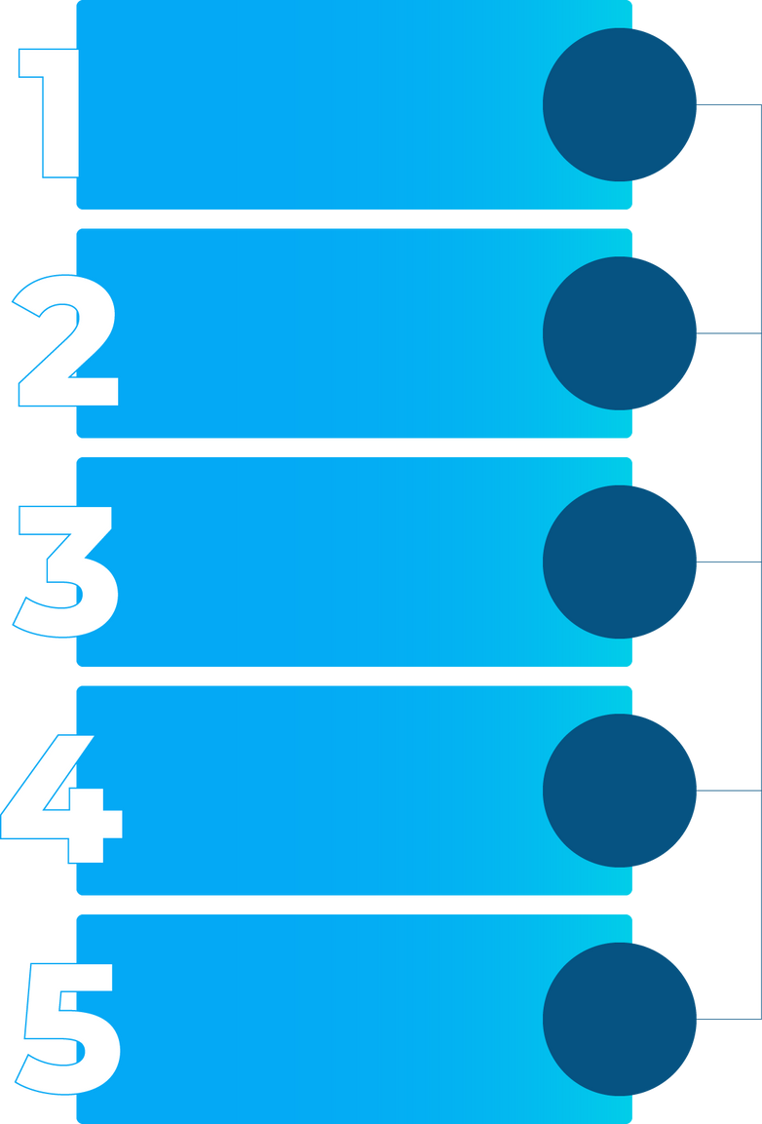
Methodology (Overview)
Input
Title: Methodology
Preprocessing
Use pre-trained YOLOv8 model
Detection Model (YOLOv8)
Capture video using OpenCV
Perform object detection
Visualize results
Output Visualization
Deploy using Streamlit
Web Deployment

Slide 10
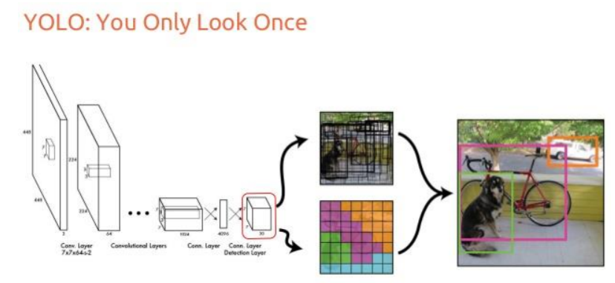
Methodology (Model)
Title: Detection Model – YOLOv8
Single-stage detector
Custom Trained on Fruit Dataset
YOLOv8 Nano used for real-time inference

Slide 11
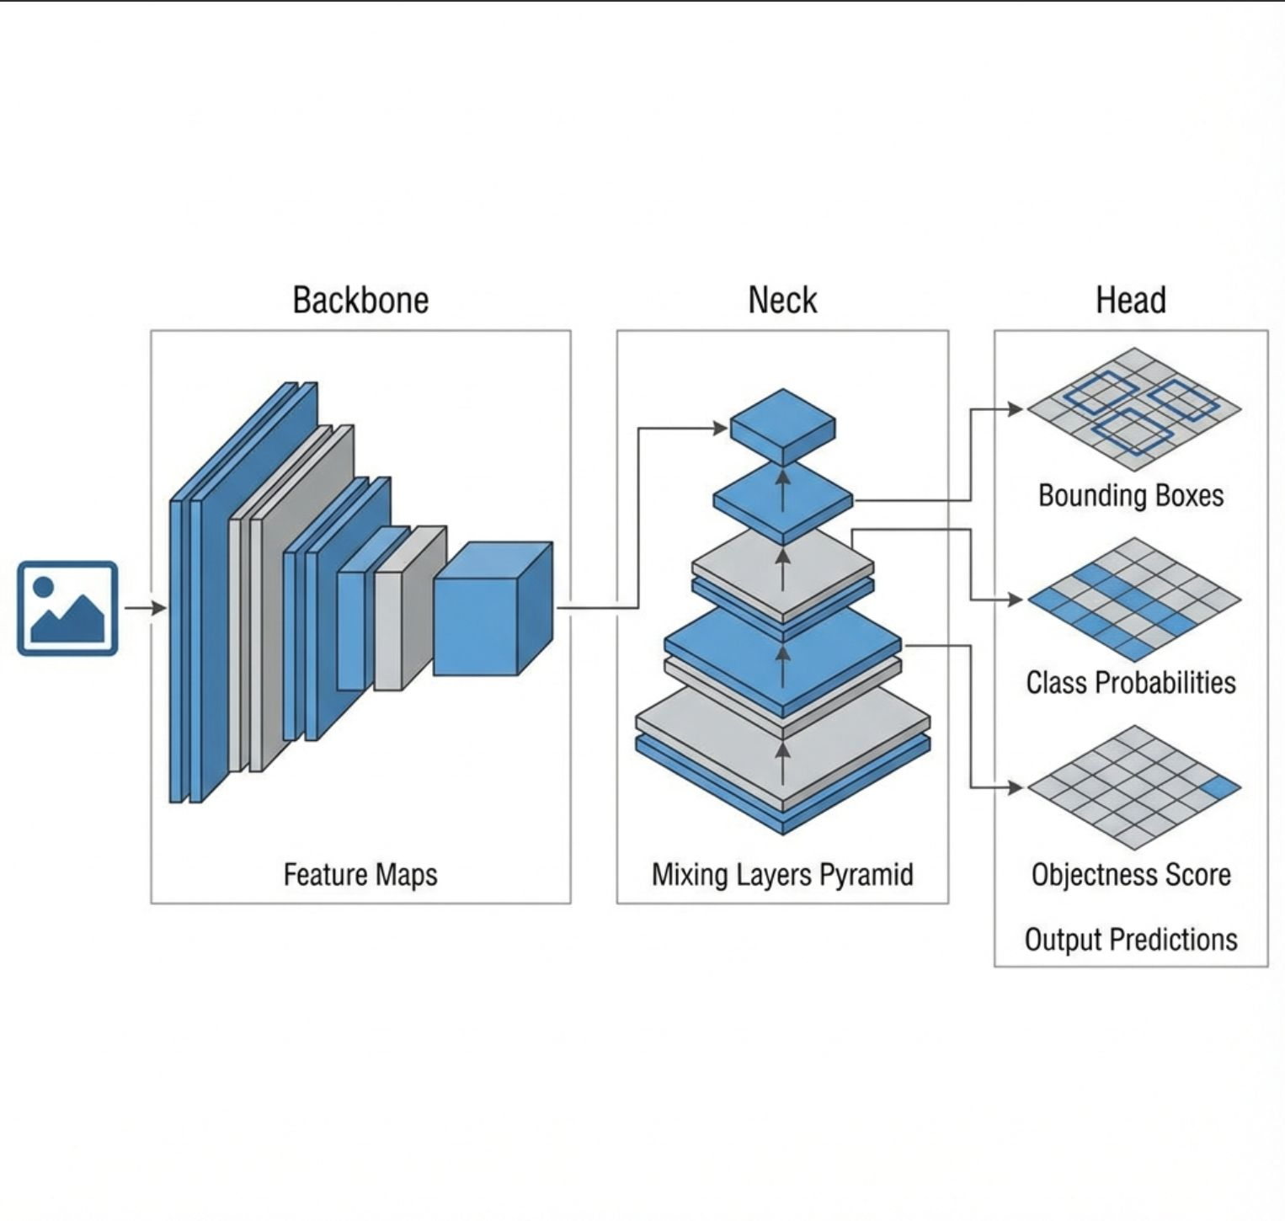
Model Architecture (YOLO)
Title: Detection Model – YOLOv8
Backbone – Feature extraction
Neck – Feature aggregation
Head – Bounding box & class prediction

Slide 12
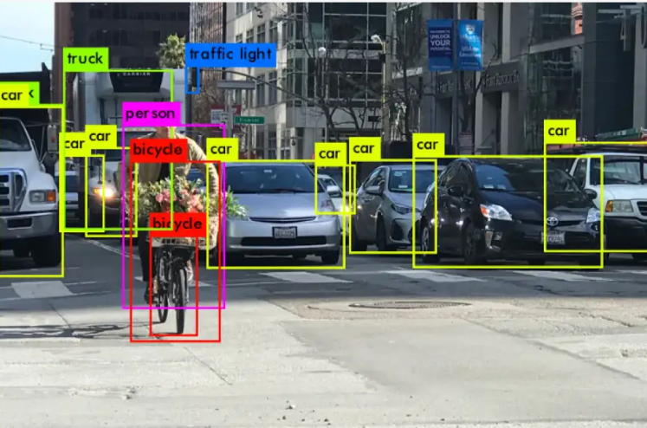
Model Selection: Why YOLO?
Title: Detection Model – YOLOv8
Single-stage detector for real-time performance
High inference speed with competitive accuracy
End-to end object detection in one forward pass
Scalable model sizes (Nano – Medium)
Strong community & pre-trained weights

Slide 13


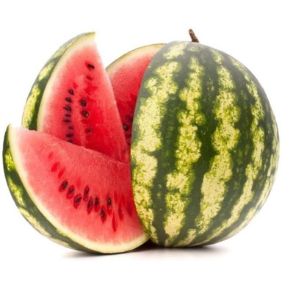
Methodology (Dataset)
Title: Dataset
COCO Dataset (pre-trained)
Fruits-262 dataset (future fine-tuning)
9 fruit classes
100 images per class

Slide 14




Methodology (Tools)
Title: Tools & Technologies
Python
YOLOv8
OpenCV
Streamlit
PyTorch

Slide 15
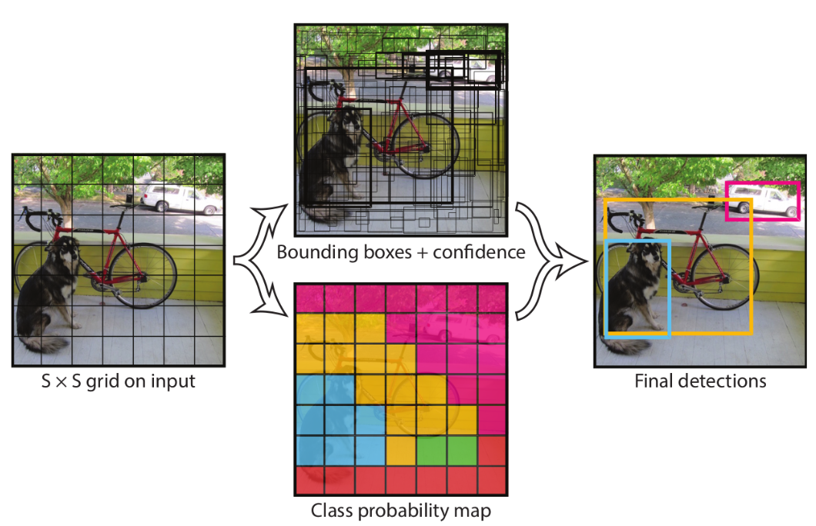
How the YOLO Detection System Works ?
Image divided into grid cells
Bounding box and class prediction
Single forward pass detection

Slide 16
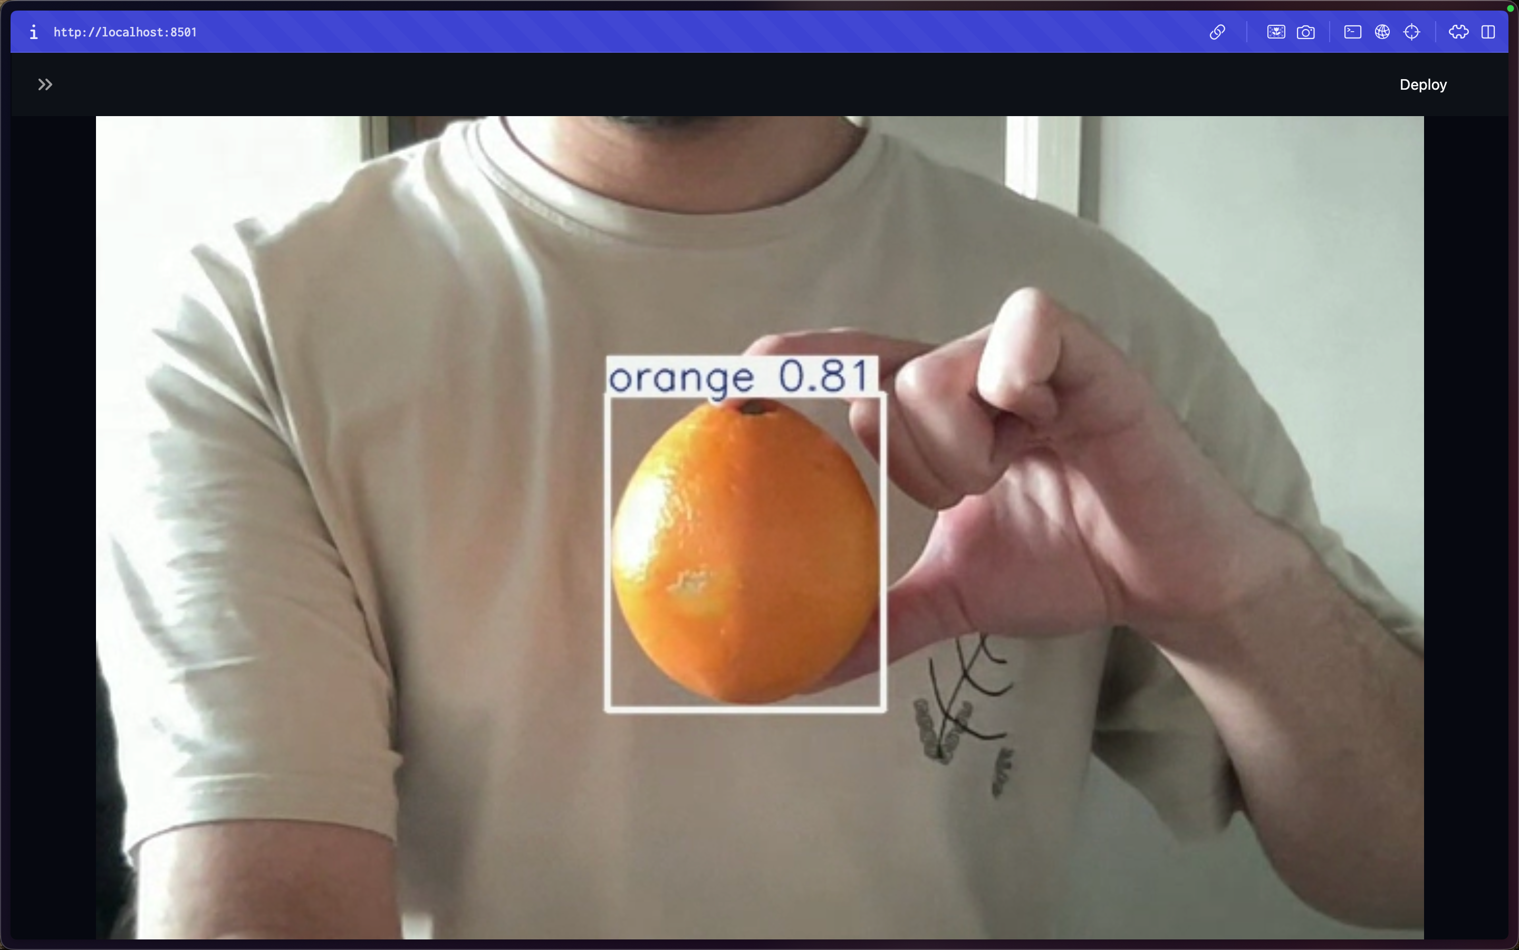
Experiment Results (Current)
Title: Experimental Results
Real-time detection achieved
Approx. 30 FPS
Qualitative results available

Slide 17
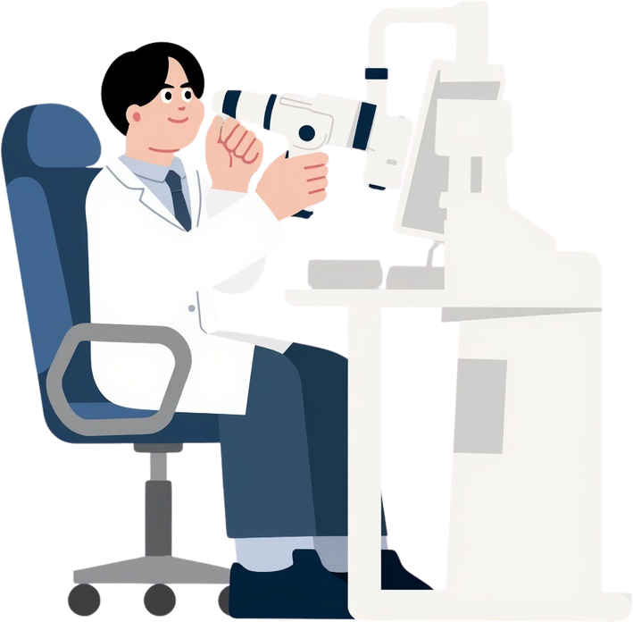
Experiment Results (Evaluation – Planned)
Title: Evaluation Metrics
Model | Precision | Recall | mAP@0.5 | mAP@0.5:0.95 | Inference
YOLOv5m | 0.77 | 0.72 | 0.767 | 0.614 | ~10 ms
YOLO11m | 0.74 | 0.76 | 0.778 | 0.627 | ~13 ms
YOLOv8 | 0.75 | 0.75 | 0.765 | 0.612 | ~11 ms
YOLOv11m achieved the highest detection accuracy, while YOLOv5m provided the fastest inference time.

Slide 18

Demo
Title: Live Demo
Webcam-based detection
Bounding boxes & confidence scores
Real-time performance

Slide 19
Conclusion
Title: Conclusion
A working real-time prototype was developed
Stable performance achieved
Strong foundation for future improvements

Slide 20
Recommendation (Future Work)
Title: Recommendations & Future Work
Dataset annotation
3D Localization
Performance comparison
Deployment optimization

Slide 21
THANK YOU
For Attention

